Slide 1




Data Dive/Hackathon
Queen’s University Belfast
22 January 2020

Slide 2
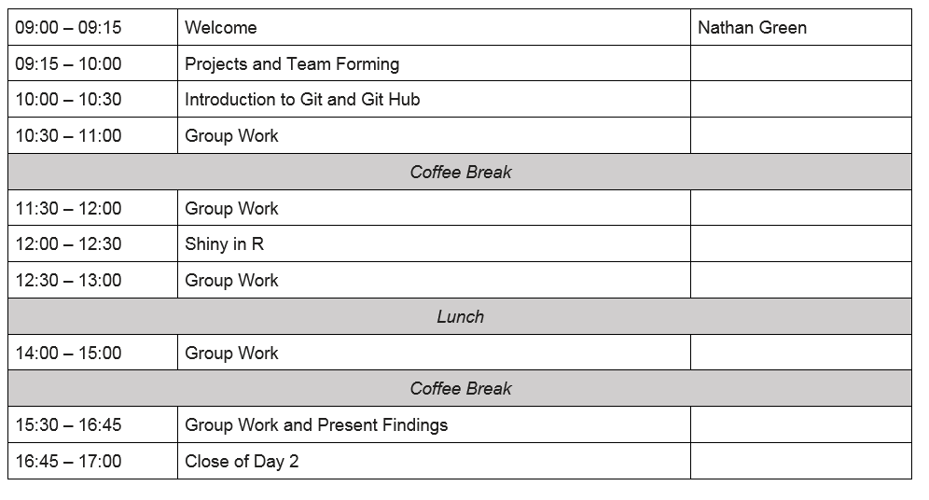

Slide 3
Outcomes
Capacity building.
Kick-start early-stage collaboration among academics, government and industry.
Set-up new networks to promote the exchange of ideas, information sharing, best practice, and other research goals.
Strengthen existing and establish new communities of interest.
Propose future collaboration and projects.
Establish a hackathon format for future events around other economic evaluations themes.
Specific outcomes include:
Packages published on public code repositories GitHub/CRAN.
Papers accompanying R packages and their applications (Journal of Scientific Computing, Medical Decision Making, Journal of Open Software)
Conference contributions

Slide 4
Health Economics Hackathon 2019
Imperial College London
https://github.com/HealthEconomicsHackathon

Slide 5
Hacking is creative problem solving.
Get involved, speak up, ask questions
Be curious
Be open-minded
Have fun!

Slide 6
Problem themes
Three broad areas:
Data cleaning, munging, pre-processing
Modelling
Plotting, visualisation

